Slide 1
Routing Your Microservices Traffic

Slide 2
Overview
The role of routing in microservices
Problems with the status quo Describing Spring Cloud LoadBalancer Creating and configuring LoadBalancers Describing Spring Cloud Gateway Creating and configuring a Gateway Summary

Slide 3
Capabilities That We Will Add in this Module
Toll Station UI
 | Service |  | Load Balancer |  | Circuit Breaker
 | Discovery
Toll Data Repository
 | API Gateway
Toll Rate Lookup Service
Messaging
Fast Pass Service
Remote Toll Data Pipeline
Toll Intake Service

Slide 4

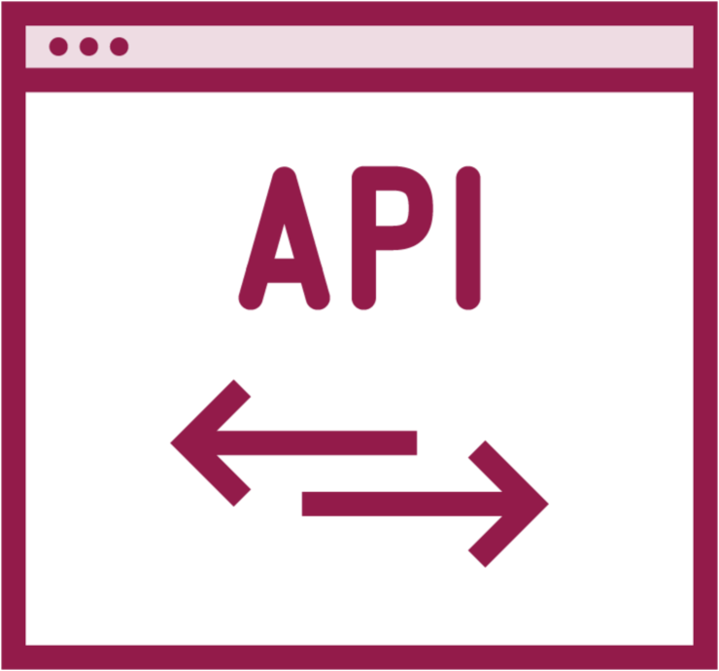
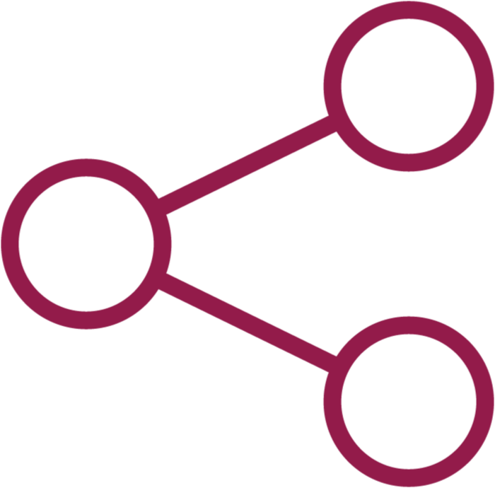

The Role of Routing in Microservices
Rapid decision making
Developer- centric options for services
Address cross- cutting concerns
Offer data aggregation to limit chatiness

Slide 5

Problems with the Status Quo
Centralized load balancers, API gateways
Routing tech focused on public services
API granularity often at odds with client demands
Different performance, needs for different clients
Tools that don’t account for constant change

Slide 6
Spring Cloud LoadBalancer
Client-side software load balancer.

Slide 7
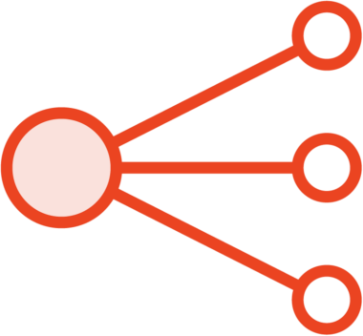


Key Concepts
Simple client-side load balancer with two provided algorithms: round-robin and random
Activated in code with class path dependencies and then @LoadBalanced annotation or reactive filter
Extend or override using configuration classes

Slide 8
Configuring a LoadBalancer in Your Applications
Starter dependency is spring- cloud-starter-loadbalancer
Configure with hard-coded list of servers or use a DiscoveryClient
Chose RestTemplate or WebClient
Supports same instance preference, sticky sessions, request transformations

Slide 9

Demo
Open client application and add LoadBalancer dependency
Add list of target servers in custom configuration
Add annotations to indicate the LoadBalancerClient
Run client application and see load balancing occur

Slide 10
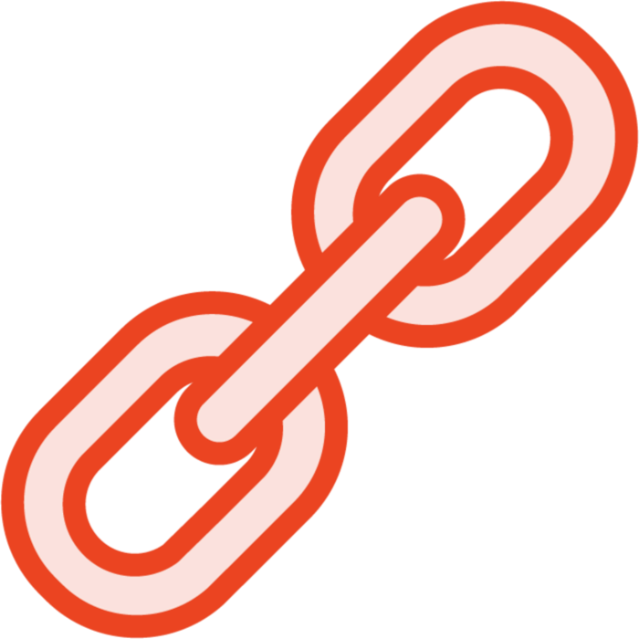
How LoadBalancer and Eureka Work Together
Eureka simplifies service discovery
Server list can come from Eureka
LoadBalancer works natively with DiscoveryClients
Respects zone configuration defined in the Eureka Discovery Client

Slide 11
Demo
Re-enable Eureka client dependency to the application
Remove custom configuration and add Discovery Client
Test the client application

Slide 12

◀ Create bean that overrides default round robin configuration
@Bean ReactorLoadBalancer<ServiceInstance>
randomLB(Environment env, LoadBalancerClientFactory factory) {
String name = env.getProperty(factory.PROPERTY_NAME);
return new RandomLoadBalancer(factory.getLazyProvider(name, ServiceInstanceListSupplier.class), name);
}
...
@LoadBalancerClient(name="fastpass-service", configuration=LoadBalancerAlgorithmConfig.class)
@SpringBootApplication
public class FastpassUiApplication { public static void main(String[] args) {
SpringApplication.run(FastpassUiApplication.class, args);
}
◀ Add annotation to ensure that this configuration is used by autowired load balancer

Slide 13
Demo
Add LoadBalancer configuration class to change from RoundRobin to Random algorithm
Annotate primary class to change bheavior Observe behavior of the running app

Slide 14
Spring Cloud Gateway
Embedded proxy for routing traffic in a microservices architecture.

Slide 15
How Spring Cloud Gateway Works
Client
Public-facing network
Gateway
Circuit Breaker
Load Balancer
Internal network
Eureka Registry
2 service
V1 service
V
V1 service
V1 service
V1 service

Slide 16

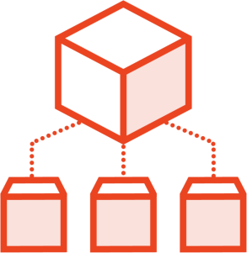

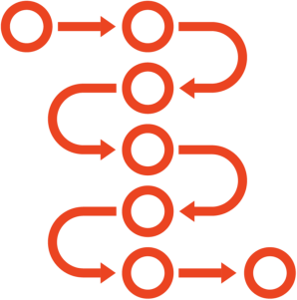
The Key Ideas for Spring Cloud Gateway
Built entirely on Spring WebFlux and Project Reactor
Routes are made up of IDs, URIs, and collections of predicates and filters
Built-in and custom predicates are used to match request attributes to a route
Built-in and custom filters let you change incoming HTTP requests and outgoing HTTP responses

Slide 17
Create a Gateway
Add dependency on spring- cloud-starter-gateway
Optionally add Eureka for service discovery
Set up fine-grained rules for matching routes
Shape the path and change the payload(s) with filters

Slide 18
spring:
cloud:
gateway:
routes:
- id: svc
uri: http://localhost:8085 predicates:
- Method=GET
Configuring Routes – Fixed endpoints

Slide 19
cloud:
spring:
gateway:
discovery:
locator:
enabled: true
routes:
- id: svc
uri: lb://customer-service predicates:
- Method=GET
Configuring Routes – Discovery-based endpoints

Slide 20
routes:
id: svc
uri: lb://customer-service predicates:
Path=/api/customers/{id} filters:
SetPath=/customerservice/{id}
Configuring Routes – Changing route paths

Slide 21
routes:
id: svc
uri: lb://customer-service predicates:
Path=/api/customers/{id} filters:
AddResponseHeader=X-Header, this is the value
Configuring Routes – Adding a header to the response

Slide 22
Create new project from Spring Initializr
Add dependency on Spring Cloud Gateway Set up with local URL, no Eureka
Demo
Test out experience with hard-coded URL
Add Eureka dependency and test using that configuration

Slide 23
About Filters and Stages
Caller
http request
http response
Filter chain
“pre “
filters
“routing” filters
“post”
filters
Global filters
Proxied Service

Slide 24
Working with Filters
Built-in Gateway, Global, and HttpHeaders filters
Custom filters can take in data, act on payloads
Filters stack on top of each other
Filters ordered automatically, can be overridden

Slide 25
Demo
Create v2 of the toll service operation and use the gateway to front each version
Add a response header to the v1 telling users they need to migrate to v2

Slide 26
Summary
The role of routing in microservices
Problems with the status quo Describing Spring Cloud LoadBalancer Creating and configuring LoadBalancers Describing Spring Cloud Gateway Creating and configuring a Gateway Summary

